Slide 1
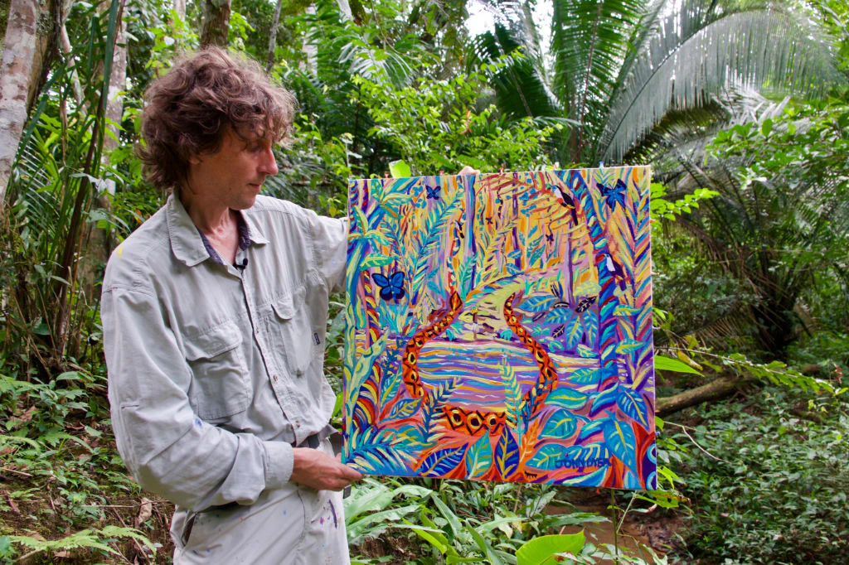
Y6 ART UNIT
Artist Focus: John Dyer

Slide 2
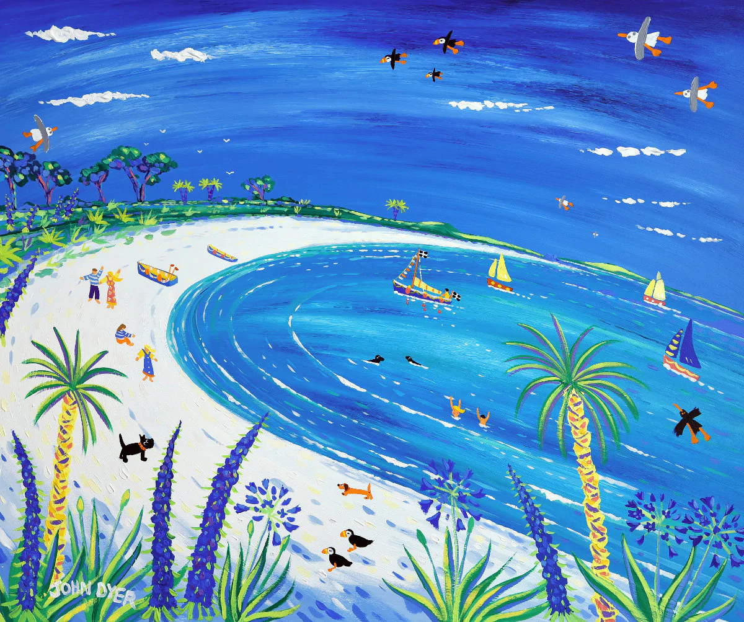
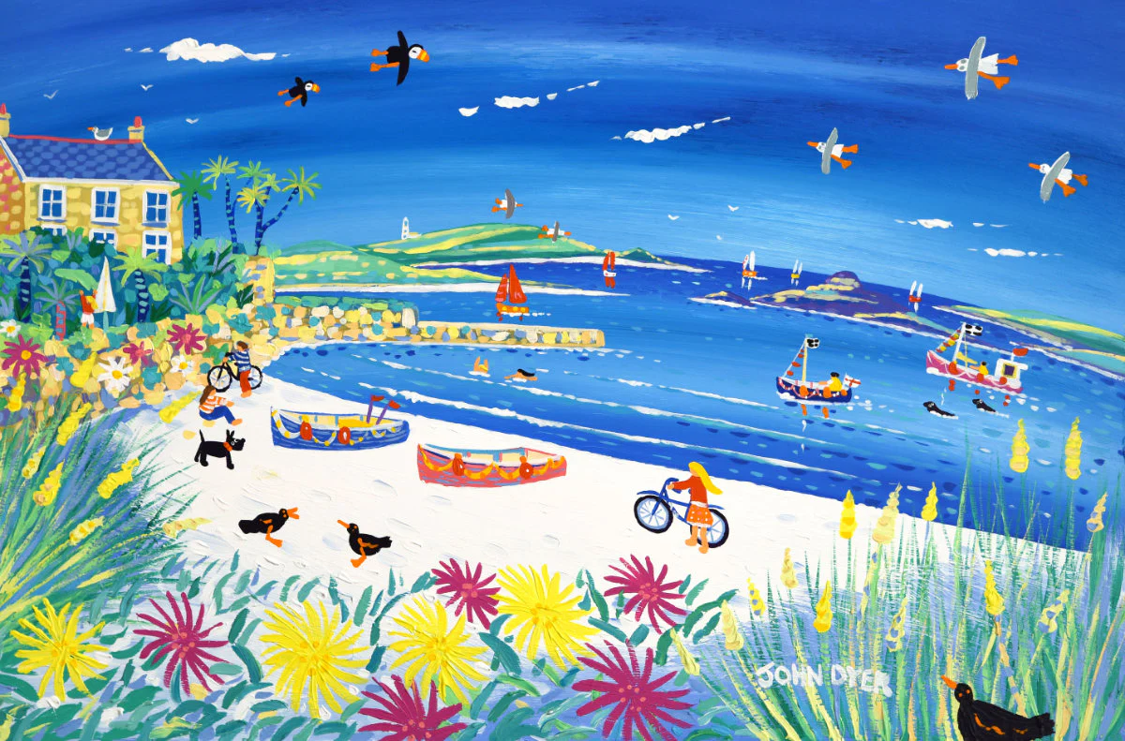
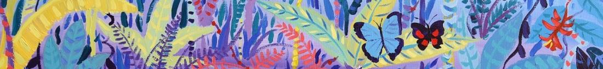
Camel
Let’s look at some of his artwork…
John Dyer – Cornwall art. What do you notice?
© John Dyer Gallery
© John Dyer
© John Dyer

Slide 3
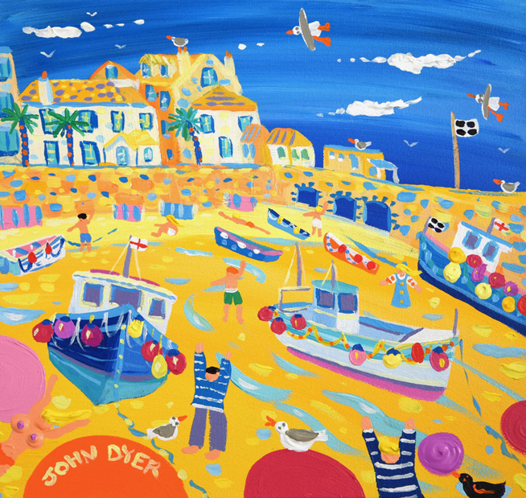
Camel
Let’s look at some of his artwork…
John Dyer – Cornwall art. What do you notice?
Create 2/3 word phrases to describe what you notice.
WAGOLLs:
deep blue sky
sweeping brush strokes
strong bright colours
© John Dyer Gallery
© John Dyer
© John Dyer

Slide 4
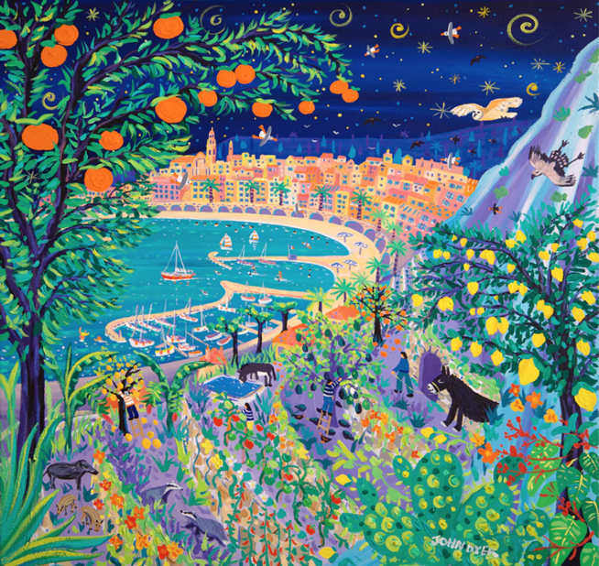
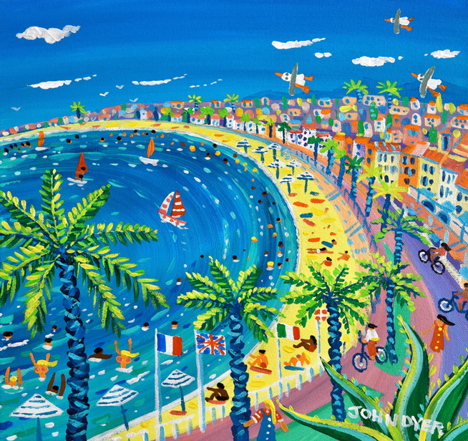
Camel
Let’s look at some of his artwork…
John Dyer – France/Italy. What do you notice?
© John Dyer Gallery
© John Dyer
© John Dyer

Slide 5
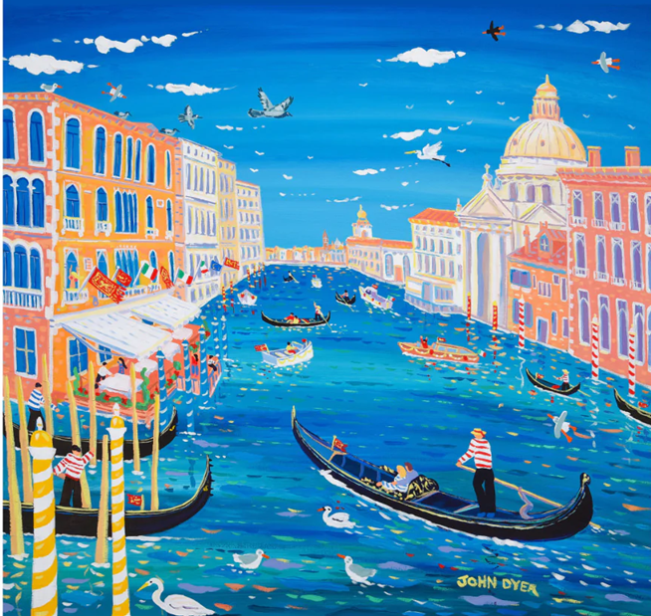
Camel
Let’s look at some of his artwork…
John Dyer – France/Italy. What do you notice?
Create 2/3 word phrases to describe what you notice.
WAGOLLs:
deep blue sky
sweeping brush strokes
strong bright colours
© John Dyer Gallery
© John Dyer
© John Dyer

Slide 6
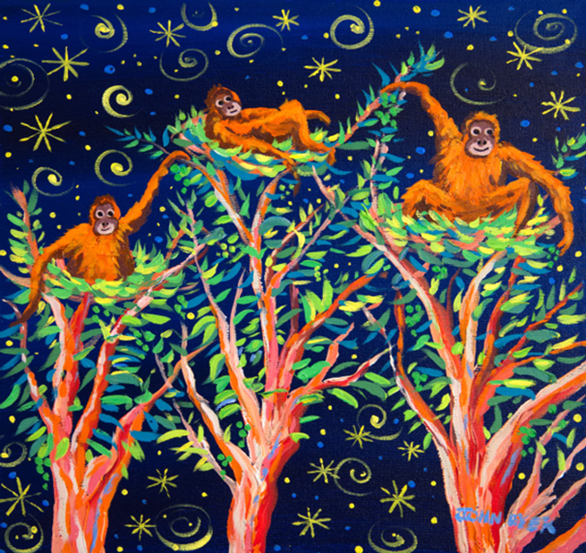
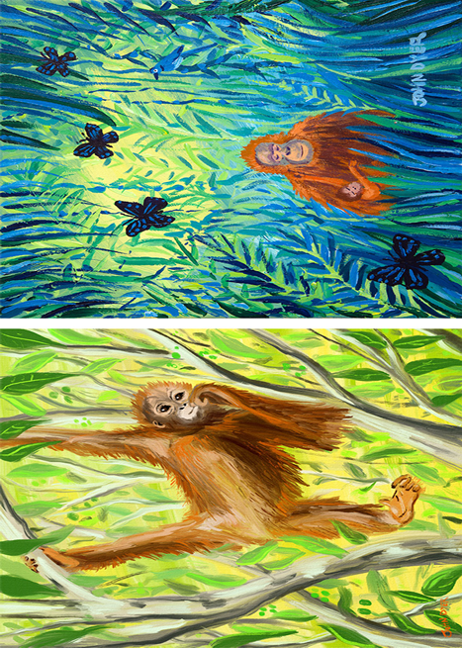
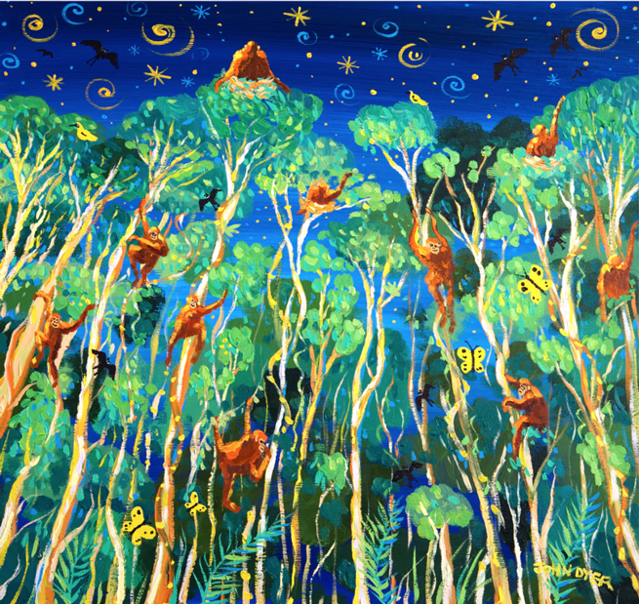
Camel
Our Focus…John Dyer - Borneo
How are they the same as his other works? How are they different?
© John Dyer Gallery
© John Dyer
© John Dyer

Slide 7
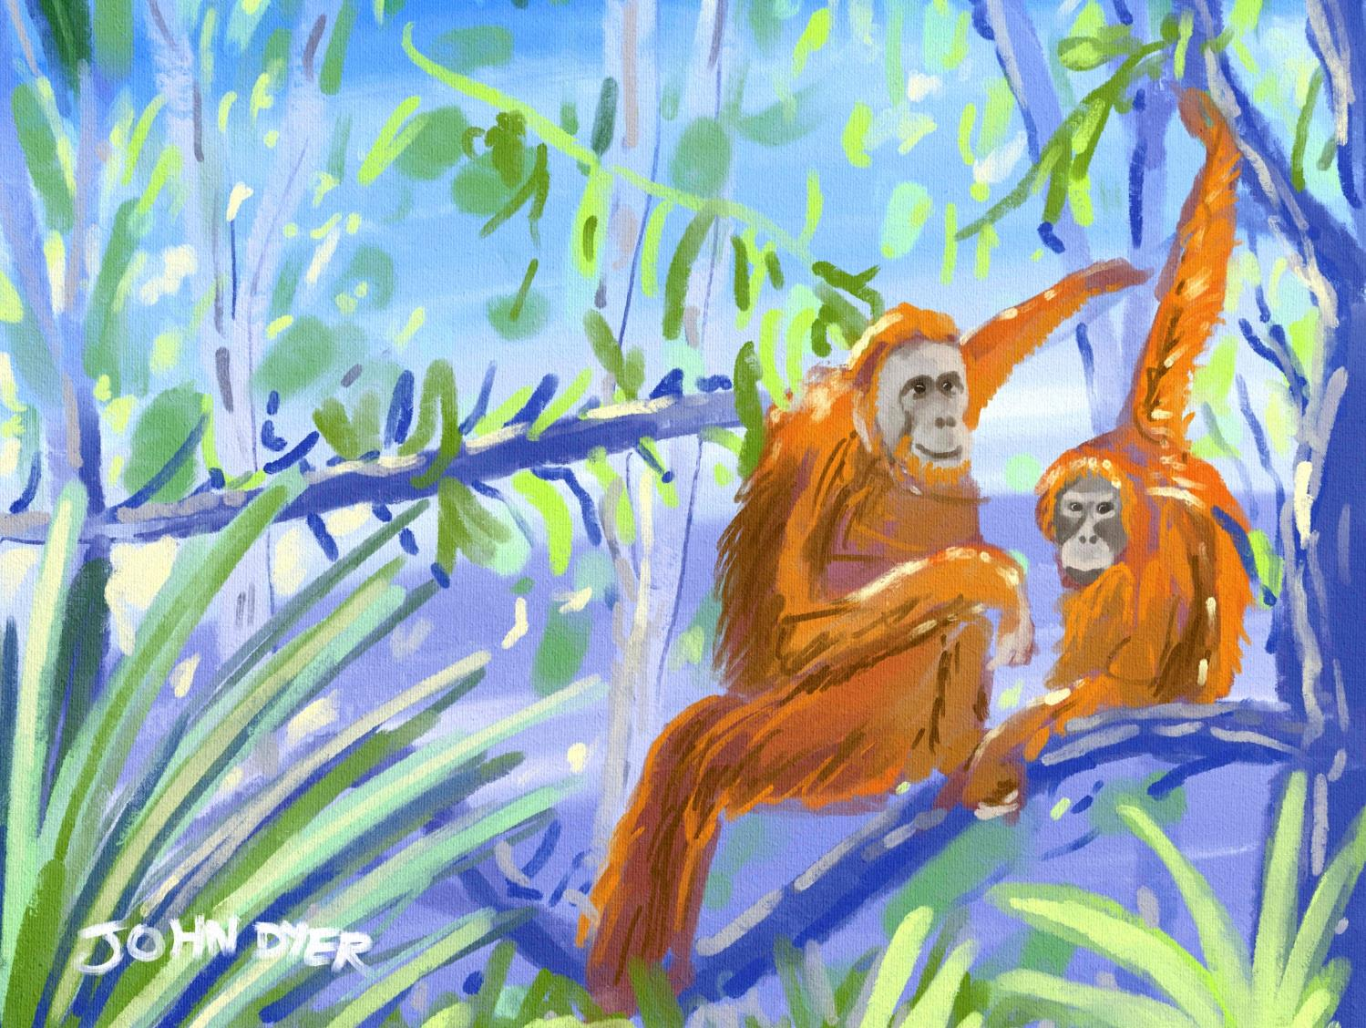


Learning objectives:
To describe the location of Borneo
To compare the culture and customs of the Penan and your own
To experiment with tonal drawings.

Slide 8

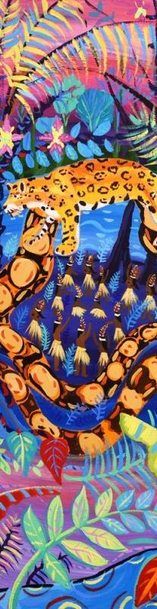
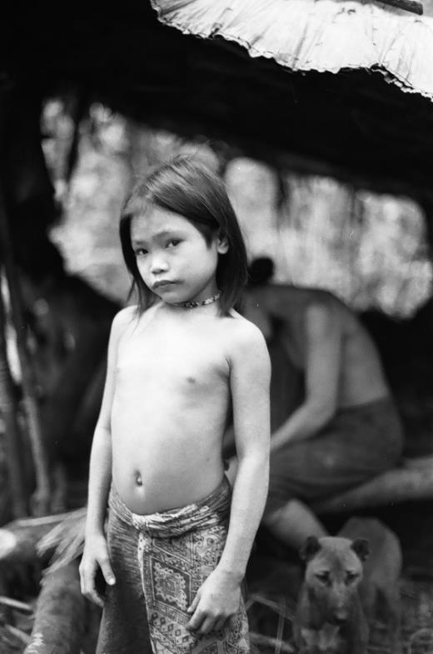
What is a tonal drawing:
Using light and shade to create a shape or image.
Activity:
Making the best of limited resources – what can you do with just two materials?
Using the provided line drawing of the Penan girl to work on top of, establish the areas of tone.
Possible materials:
Worksheet or blank paper
Drawing materials such as:
  Soft pencil (4B or above)
  Black drawing pencil
  Charcoal
  Compressed charcoal
  Graphite stick
  Soft pastel
  Black watercolour paint.
© Robin Hanbury-Tenison

Slide 9
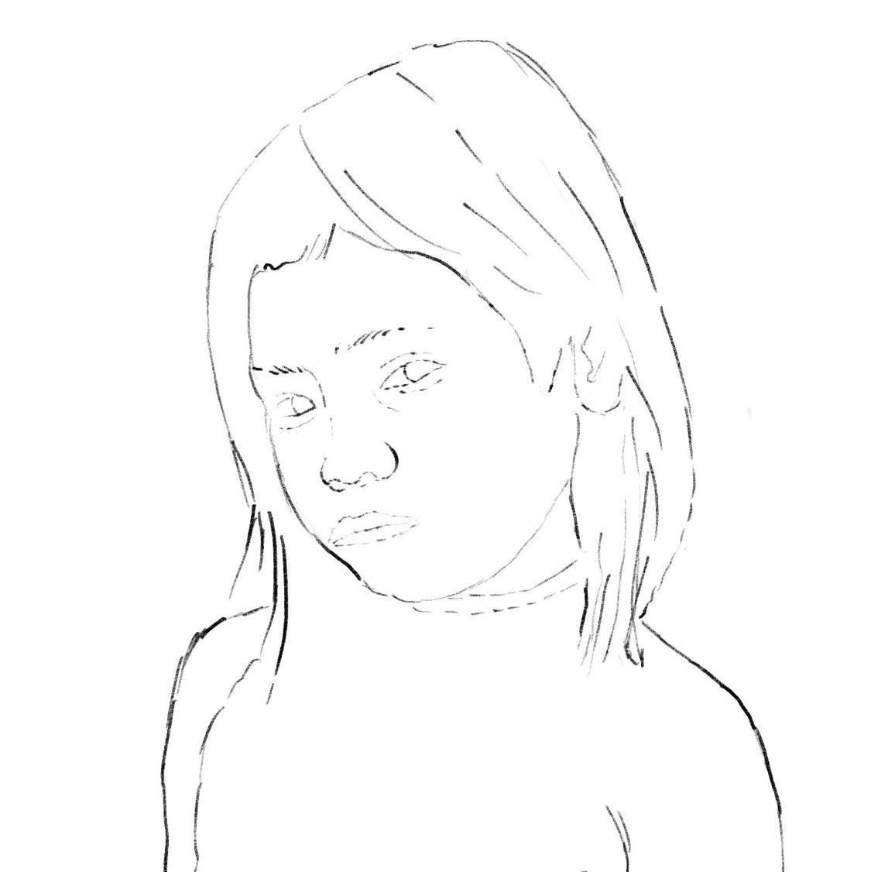
© John Dyer

Slide 10
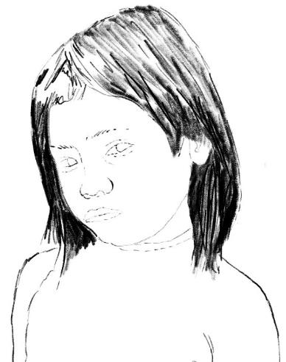
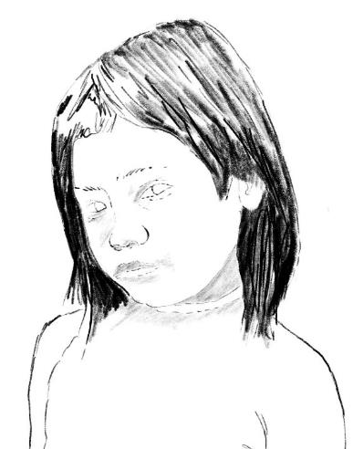
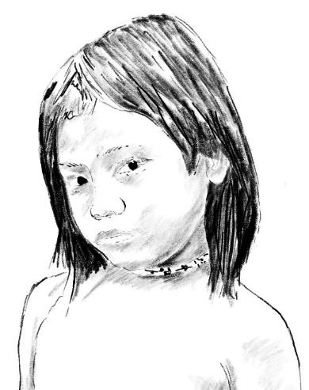
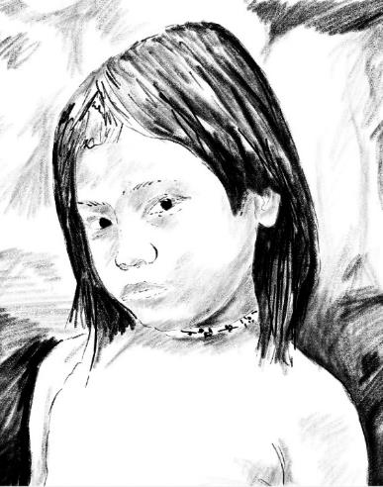
Step by step guide:
Step 1:
Very dark marks can be used for the hair of the Penan girl
Leave areas of paper white to create the shine in her hair and develop texture with your mark making or brush strokes.
Step 2:
Look carefully at the range of very subtle tones on the girl's face and gently shade those areas.
Step 3:
The area on her neck is slightly darker than her face which adds depth.
Add her dark eyes.
Step 4:
Deep textures and tones in the background give the feeling of the light and dark of the rainforest
Notice how by adding the dark background she leaps off the page and creates a very strong image.
Do you feel a connection to her?

Slide 11




© John Dyer
© John Dyer

Slide 12

© John Dyer
Learning objectives:
To describe the characteristics of the rainforest
To describe five different plants found in the Borneo rainforest.

Slide 13

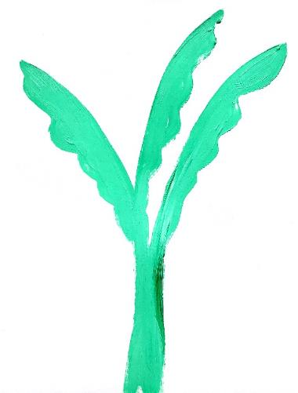
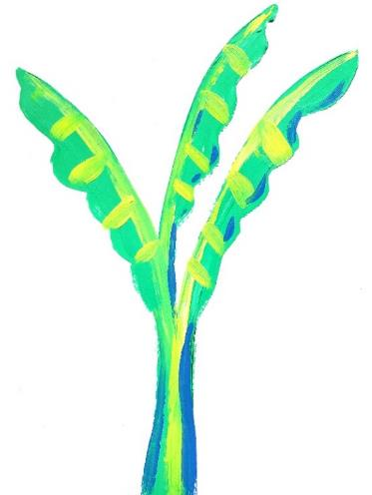
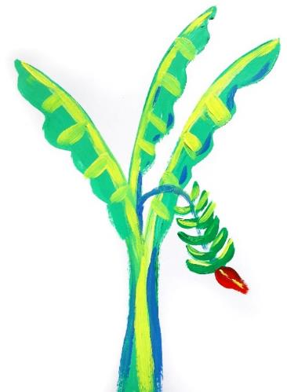
Step 1:
Choose your colour or colours
Start adding shape detail eg leaves.
Top tips:
Think carefully about the shape and colours of the plant you are going to draw
Green is a good starting colour if your plant has leaves
  Use a lighter colour for highlights
  Use a darker colour to add some shadow.
Step 2:
Think about the highlights and shadows.
Step 3:
Add any fruits or flowers to your plant if it will have them.
Step 4:
Annotate your drawing with notes about:
  Smell
  How you would get your food
  Where you would grow
  Size
  Use etc.

Slide 14

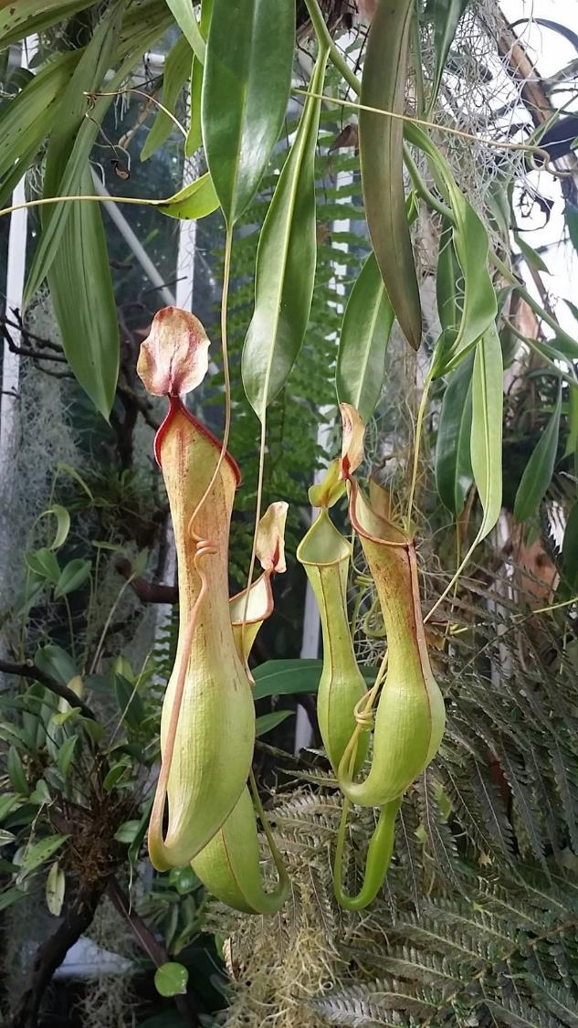

Camel
Facts:
They get their name from their shape – which allows them to trap insects
They can grow in very poor soil as they get their nutrients from their prey.
One species of pitcher plant found in Borneo has become known as the ‘shrew toilet’. It uses nectar to attract tree shrews and birds – their droppings fall into its pitcher and provide most of the plants’ nitrogen requirements.
2
Pixaby.com

Slide 15

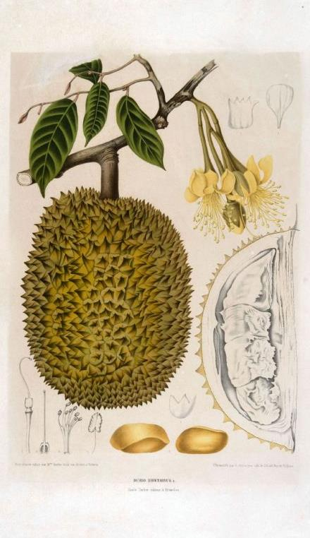
Camel
Facts:
This tree produces an edible fruit that has a custard like texture
These large fruits can be 15cm to 20cm across
The yellow flowers shed their pollen in the evening attracting bats which help to pollinate the plant.
The sometimes overpowering, sickly sweet smell of the fruit means that it is banned from some hotels and public transportation in south east Asia.
2
© Tropenmuseum, part of the National Museum of World Cultures
Notes:
Image sourced from: Wiki commons
https://commons.wikimedia.org/wiki/File:COLLECTIE_TROPENMUSEUM_De_vrucht_de_bloemen_en_het_blad_van_de_Durio_zibethinus_L._TMnr_3401-1688.jpg

Slide 16

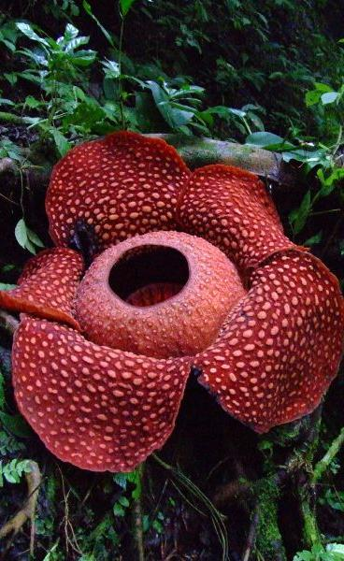
Camel
Facts:
These are parasitic plants that live inside vines (absorbing their nutrients) with only their flowers showing
They emit the smell of rotten meat to attract pollinators such as insects
There are 28 different species found across south east Asia.
A species of corpse flower (Rafflesia arnoldii) has the world’s largest flower, weighing up to 10kg each and measuring 100cm across.
2
© Tamara van Molken
Notes:
Image sourced through flickr.com
https://www.flickr.com/photos/tamaar/
https://creativecommons.org/licenses/by-nc-nd/2.0/

Slide 17

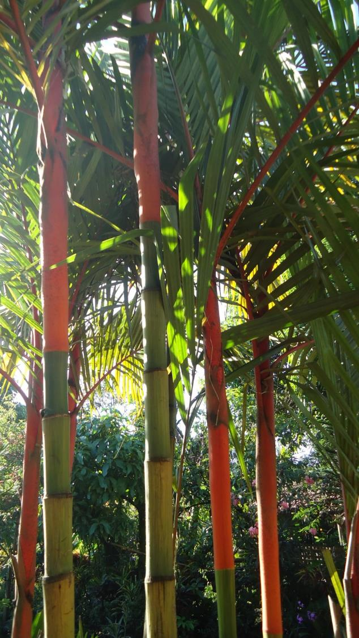

Camel
Facts:
Around 2,600 species of palm can be found around the world
Palm leaves can be enormous, for example, one oil-palm leaf can be 10m long
The lipstick palm has distinctive red leaf shafts (stems).
In 1999, the government of Indonesia brought in a new law to protected it from being harvested as it was becoming threated.
2
Pixaby.com
Wikicommons.com
Notes:
Image sourced through Flikr

Slide 18

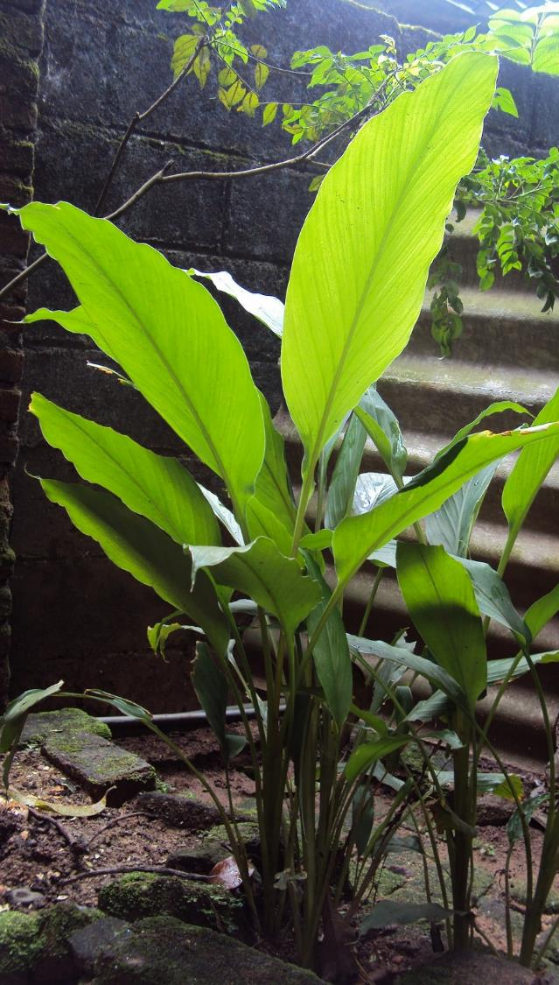
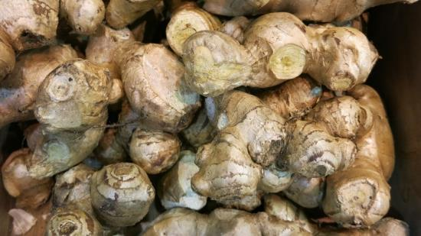
Camel
Facts:
The part of the ginger plant that is commonly used as a spice actually grows below ground – like a potato
Ginger is a herb – this means that its stem is not made of wood like a tree but of lots of sheets of overlapping leaves.
Ginger root has been in use
since ancient times and
eating it has many reported
health benefits.
2
Pixaby.com
Pixaby.com

Slide 19
© John Dyer
© John Dyer

Slide 20

© John Dyer
Learning objectives:
To learn about the diversity of animals in Borneo's rainforest
To experiment with a range or art techniques.

Slide 21

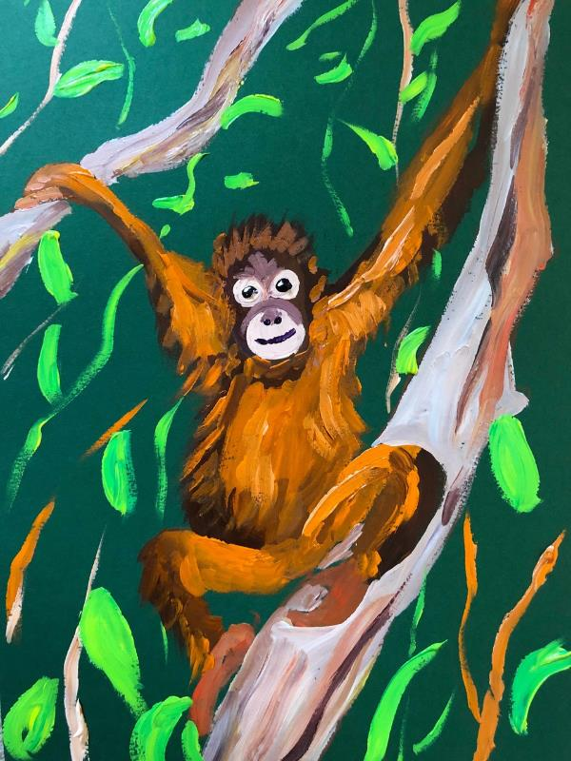
Camel
© John Dyer
Activity:
Painting an orangutan in its natural habitat.
Top tips:
You will be painting over the drawing so feel free to make many marks to slowly mould your outline to the shape you want.
Use a good brush and of the right size so you can control your marks and create hair and texture.
Possible materials:
Coloured piece of card (John used green, A4)
Drawing materials such as:
  Soft pastel
  Soft pencil
  Coloured paints
Mixing pot or pallet
Good paint brush.
© John Dyer

Slide 22
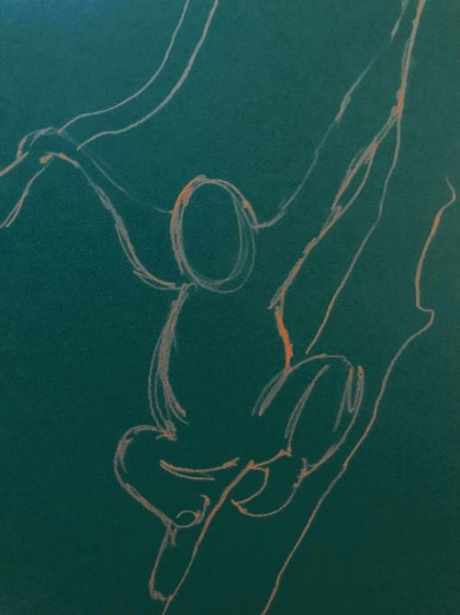
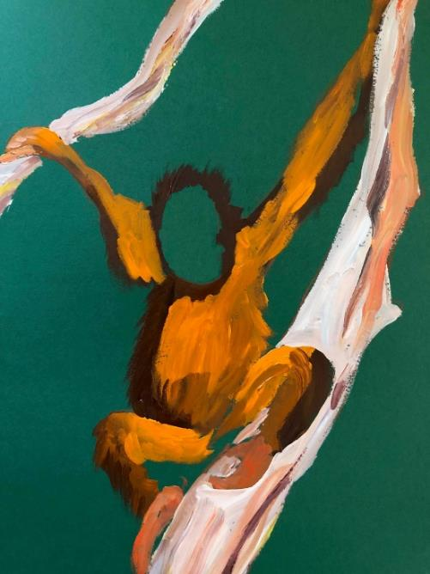
Step by step guide:
Step 1:
Using a pencil or pastel draw the outline of the orangutan and the two trees, the one it is sitting on and the one it is holding
You can use photographs of orangutans you have searched for to base this exercise on if you prefer
When drawing the body gently sketch out the head, add the round body and then work on the arms and legs.
Step 2:
Once you are happy with your sketch drawing, mix a deep brown paint for shade and a bright orange for light and start to paint on the areas of light and shade
You can mix an orange from yellow and then add a small quantity of red. To create a brown you can mix yellow with a small amount of red and then add a small quantity of blue
Allow your brush to become slightly dry and then add some dry brush strokes to add the hair of the orangutan.

Slide 23
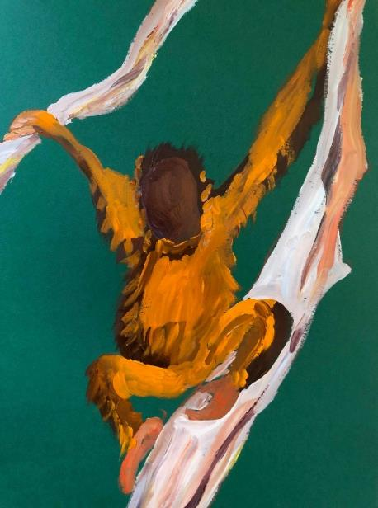
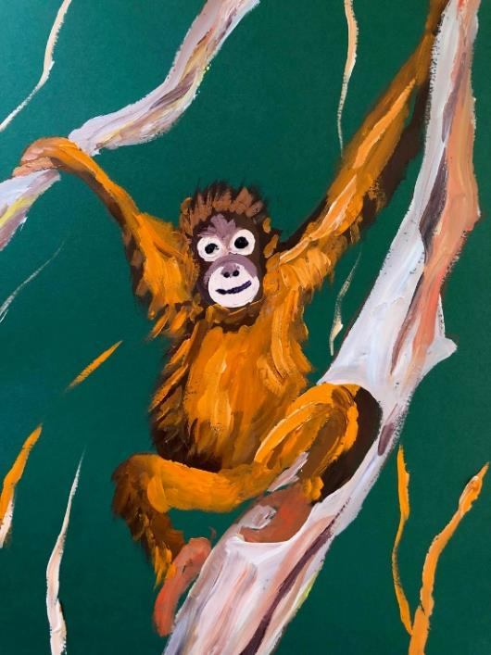
Step by step guide:
Step 3:
Paint the orangutan’s face a deep brown
You might want to let it dry at this stage or using wet on wet paint use a very pale cream/white colour to add the two eyes and nose/mouth area as circular shapes.
Step 4:
In the larger circle, the nose can be added and the mouth
Add the dark pupils to the orangutan and with a tiny touch of white you can add a reflection to the eyes to add life
Finally, if you have time, add some forest leaves in the background and make sure your trees have been painted in a pale white colour.
How do you feel about orangutans now you have painted one?

Slide 24
© John Dyer
© John Dyer

Slide 25

© John Dyer
Learning objectives:
To ask well thought out questions about a place, people and environment
To create your own rainforest inspired piece of modern art – using information and skills learnt during this course.

Slide 26

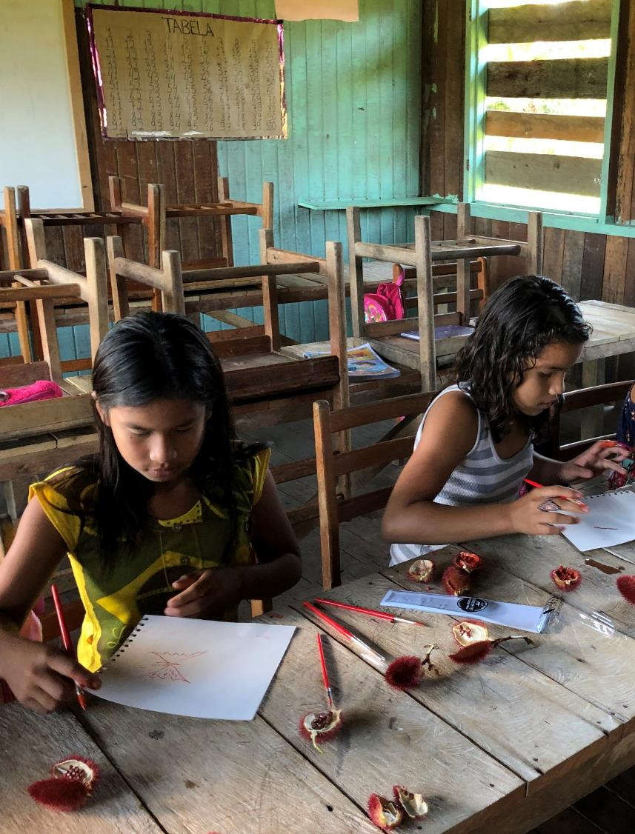

Use the techniques you have been practicing to create your own piece of rainforest inspired art.
Think about what you have learnt about the people, plants and animals of the rainforest as well as the threats they face.
Your art should aim to express your own connection with the rainforest.
© John Dyer
© John Dyer

Slide 27


We have talked about individual elements of a painting as well as some techniques, but how do you bring these together into a single piece of art?
© John Dyer

Slide 28
Camel
Your Final Piece…
You can create your own or recreate one of John Dyer’s Borneo pieces
© John Dyer Gallery
© John Dyer
© John Dyer

Slide 29
© John Dyer Gallery

Slide 30
Camel
© John Dyer Gallery

Slide 31
Camel
© John Dyer Gallery

Slide 32
Camel
© John Dyer Gallery

